Slide 1
Chapter 16-1. MOS fundamentals
Metal-oxide-semiconductor FET is the most important device in modern microelectronics.
In this chapter, we will study:
  Ideal MOS structure electrostatics
  MOS band diagram under applied bias
  Gate voltage relationship
  capacitance-voltage relationship under low frequency and under high frequency.

Slide 2
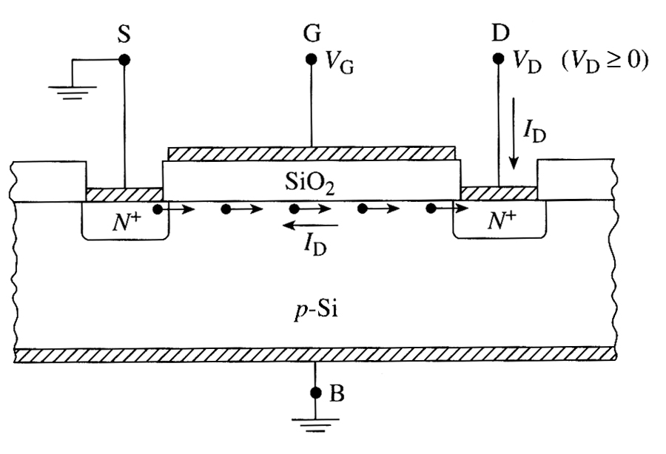
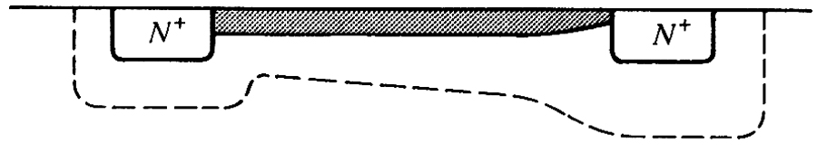
MOSFET
N-channel
MOSFET
(NMOS)
uses p-type
substrate
electrons
P-Si

Slide 3
MOSFET operation
I_{D}
Pinch-off
V_{G3}
V_{G2}
V_{G3} > V_{G2} > V_{G1}
V_{G1}
V_{D}
When a positive voltage V_{G} is applied to the gate relative to the substrate, mobile negative charges (electrons) gets attracted to Si-oxide interface. These induced electrons form the channel.
For a given value of V_{G}, the current I_{D} increases with V_{D}, and finally saturates.

Slide 4
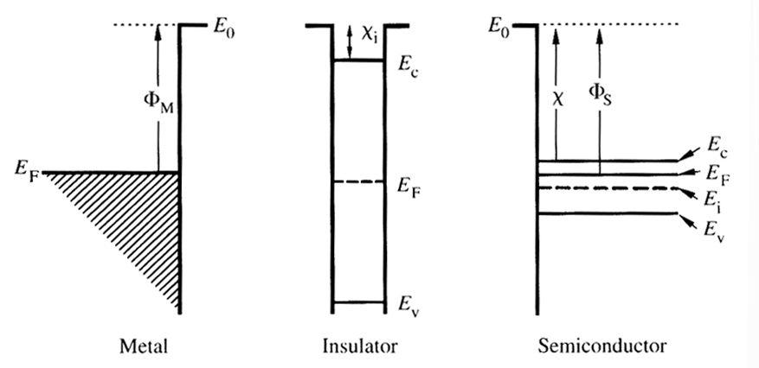
Ideal MOS capacitor
Let us consider a simple MOS capacitor and call it “ideal”
Oxide has zero charge, and no current can pass through it.
No charge centers are present in the oxide or at the oxide-semiconductor interface.
Semiconductor is uniformly doped
Φ_{M} = Φ_{S}
= χ + (E_{C} – E_{F})_{FB}

Slide 5
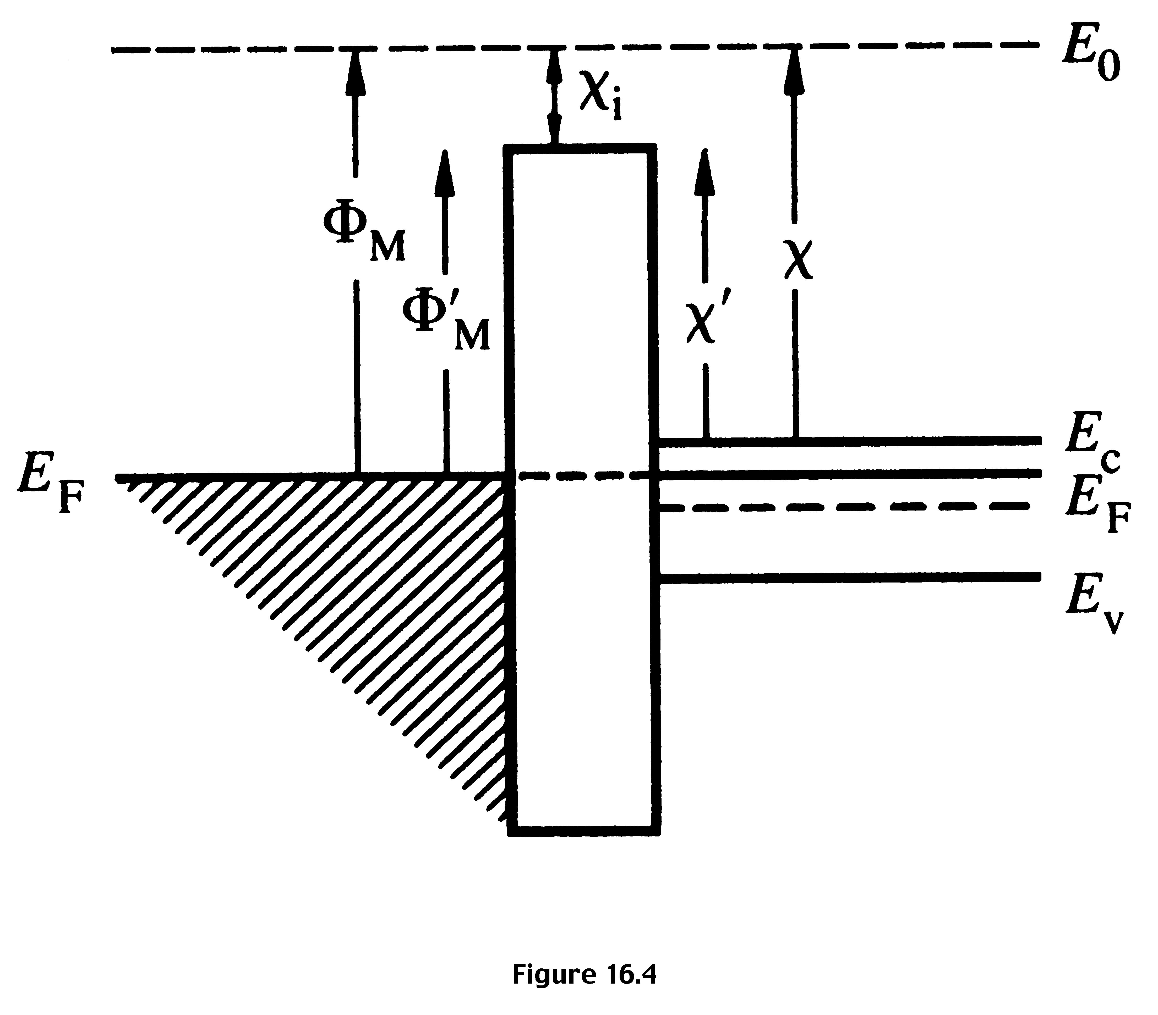
Equilibrium energy band diagram for an ideal MOS structure

Slide 6
Effect of an applied bias
Let us ground the semiconductor and start applying different voltages, V_{G,} to the gate
V_{G} can be positive, negative or zero with respect to the semiconductor
E_{F, metal} – E_{F, semiconductor} = – q V_{G}
(Since electron energy = − q V, when V < 0, electron energy increases)
Since oxide has no charge, d E_{oxide} / dx = ρ/ε = 0; i.e. the E-field inside the oxide is constant.

Slide 7

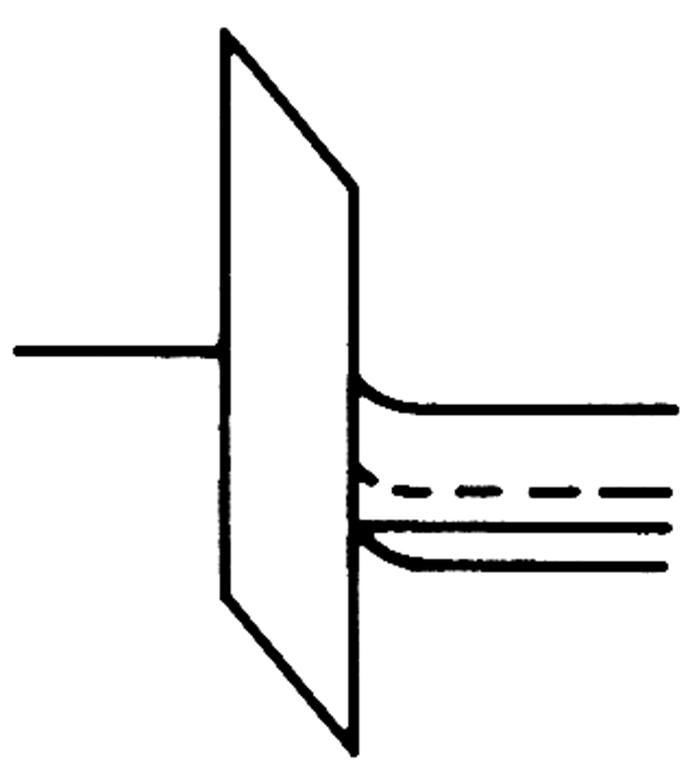
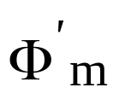
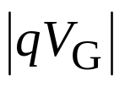
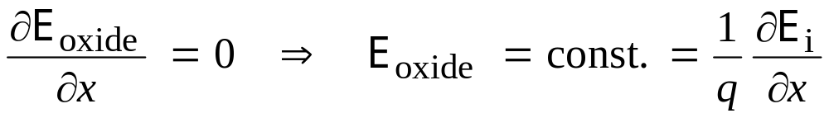
Consider p-type Si, apply V_{G} < 0
Negative voltage
attracts holes to
the Si-oxide interface.
This is called
accumulation condition.
E_{i} – E_{F} should
increases near the
surface of Si.
Accumulation
of holes
E_{C}
E_{i}
E_{Fs}
E_{V}
The oxide energy band has constant slope as shown. No current flows in Si ➔ E_{F} in Si is constant.

Slide 8



Accumulation condition, V_{G} < 0, p-type Si
M
O
p-type Si
V_{G} < 0
charge density
small
Accumulation of holes near
silicon surface, and electrons
near the metal surface.
Similar to a parallel plate
capacitor structure.
+
+
Sheet of holes
Sheet of
electrons
x
––––
x

Slide 9


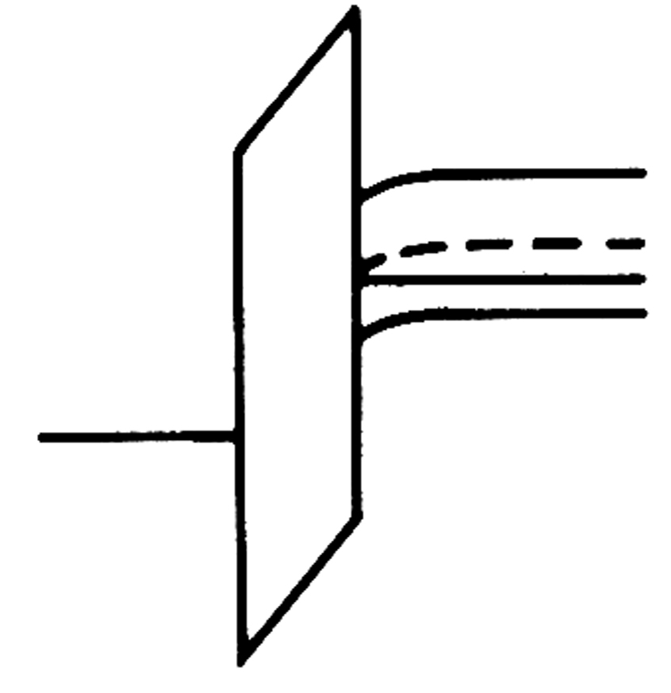


Consider p-type Si, apply V_{G} > 0 (Depletion condition)
Finite
depletion layer
width
Depletion
+
+
+
E_{C}
E_{i}
- - -
- - -
E_{Fs}
E_{V}
E_{FM}
M
O
S
x

Slide 10

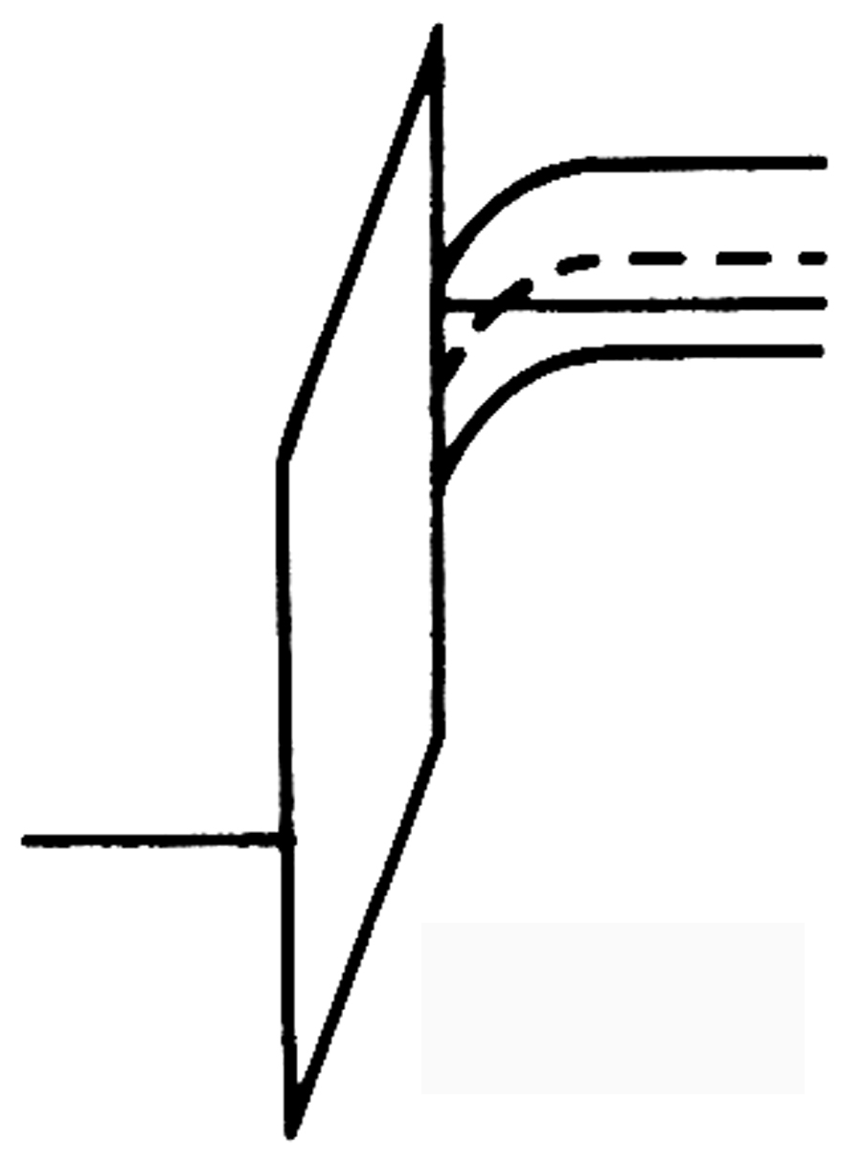
Consider p-Si, apply V_{G} >> 0 (Inversion condition)
Immobile acceptors
+
+
+
+
E_{C}
E_{i}
- - - - - - -
- - - - - - -
E_{FS}
-
-
E_{V}
Mobile electrons
E_{FM}
E_{FM}
x

Slide 11
Inversion condition
If we continue to increase the positive gate voltage, the bands at the semiconductor bends more strongly. At sufficiently high voltage, E_{i} can be below E_{F} indicating large concentration of electrons in the conduction band.
We say the material near the surface is “inverted”. The “inverted” layer is not gotten by doping, but by applying E-field. Where did we get the electrons from?
When E_{i}(surface) – E_{i}(bulk) = 2 [E_{F} – E_{i}(bulk)], the condition is
start of “inversion”, and the voltage V_{G} applied to gate is called V_{T} (threshold voltage). For V_{G} > V_{T}, the Si surface is inverted.

Slide 12
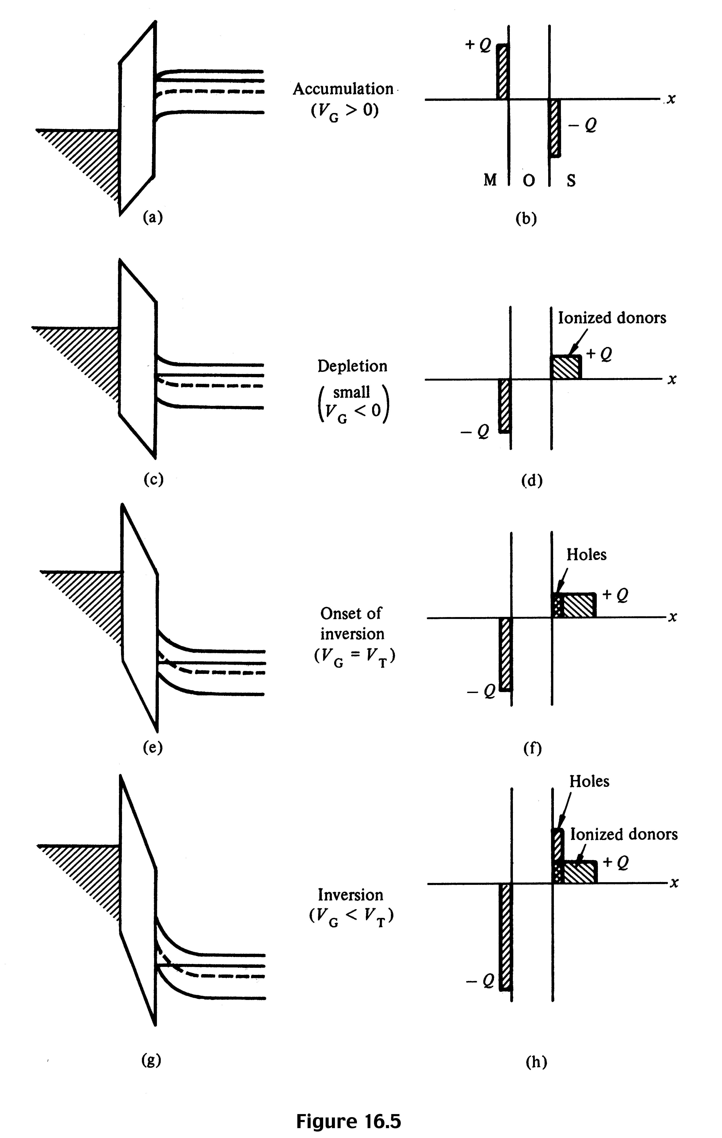
Energy band diagrams and charge density diagrams describing MOS capacitor in n-type Si

Slide 13
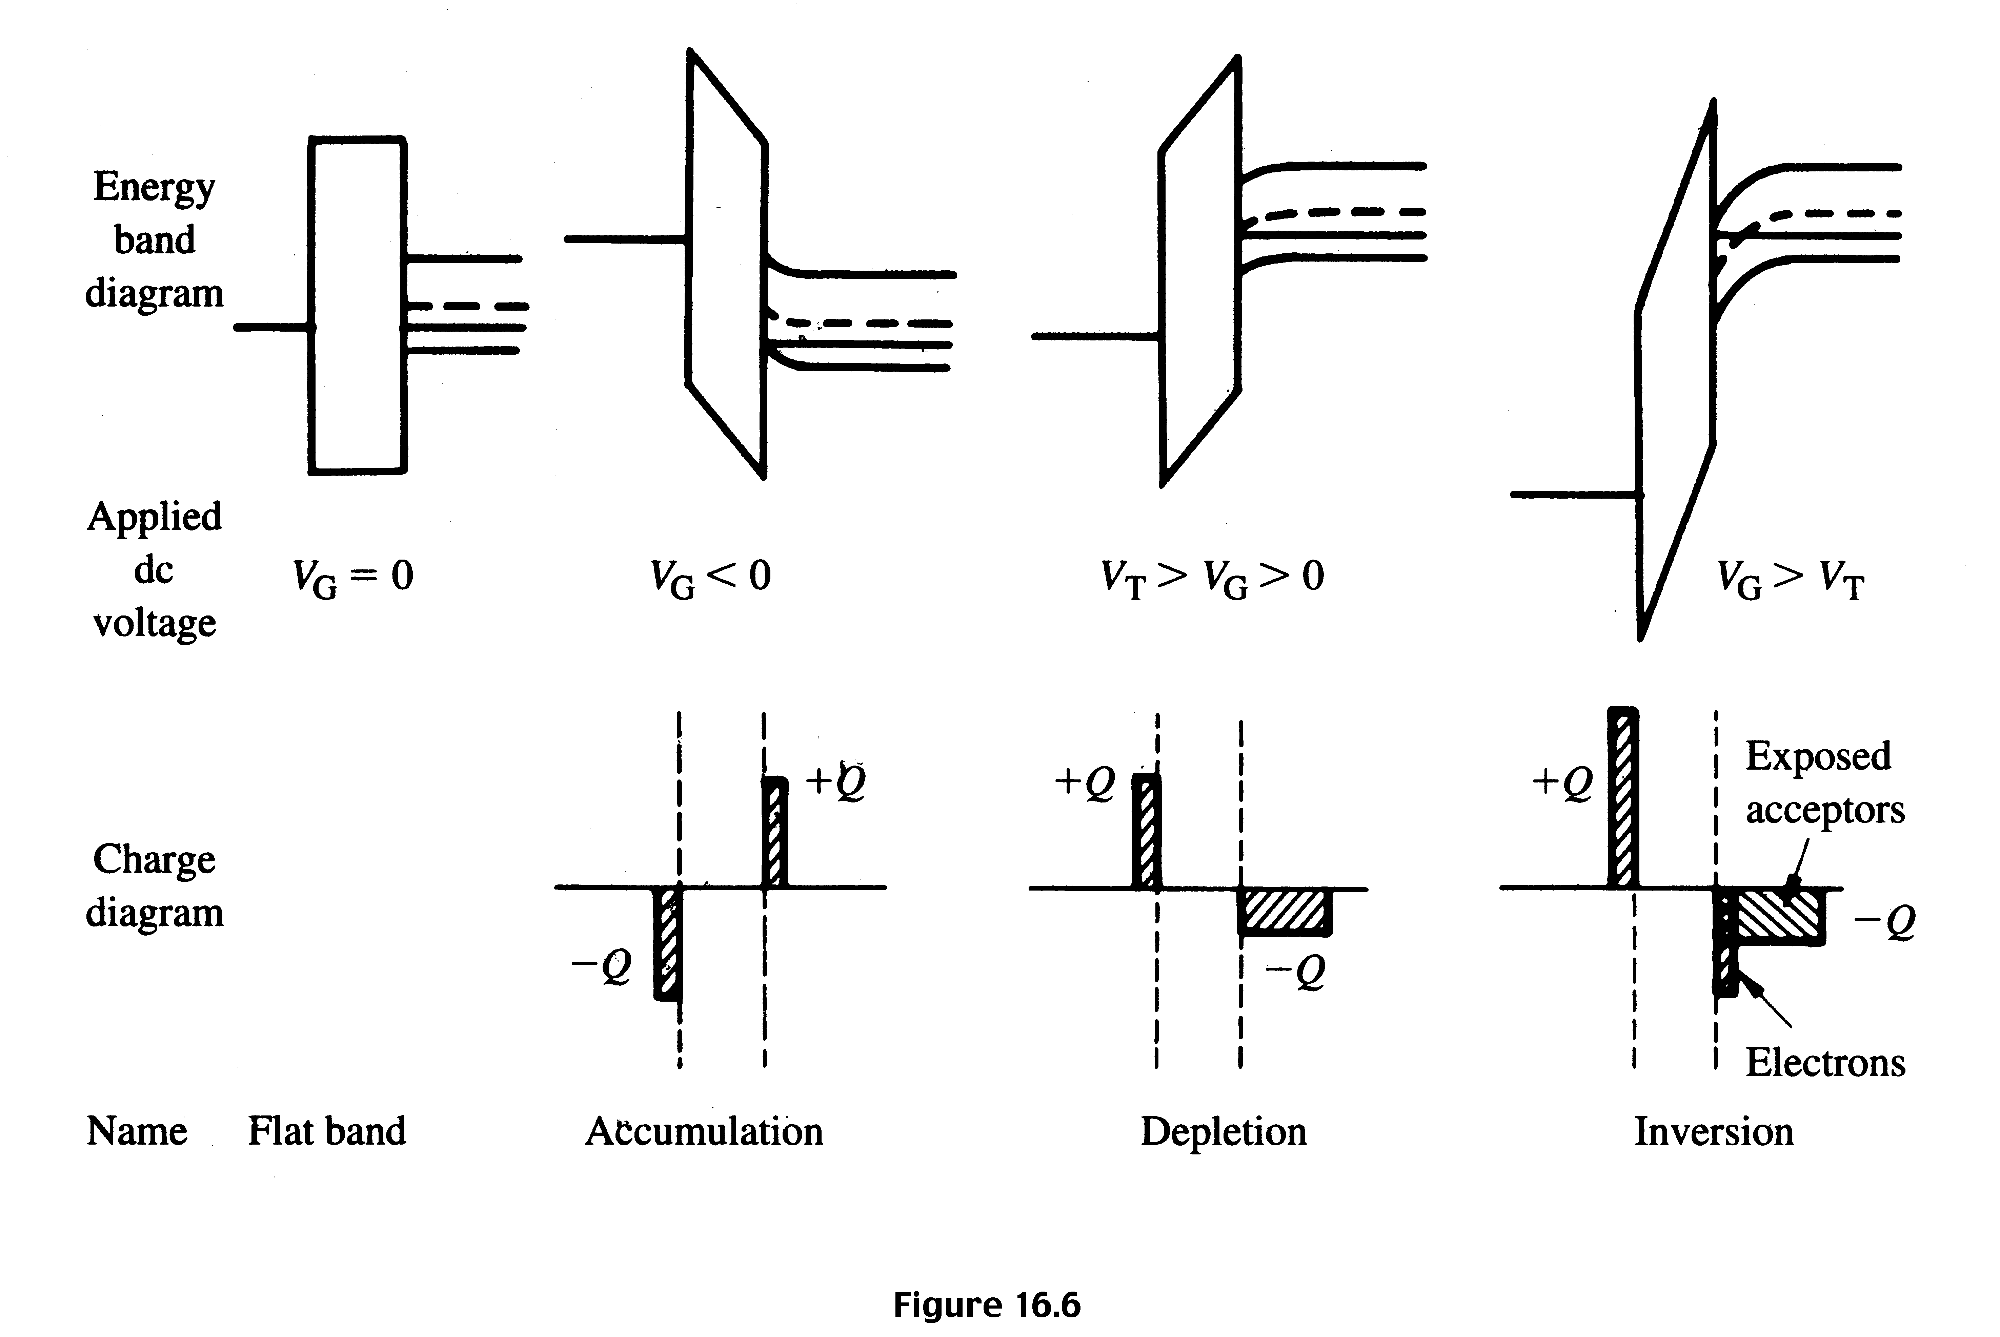
Energy band diagrams and charge density diagrams describing MOS capacitor in p-type Si

Slide 14
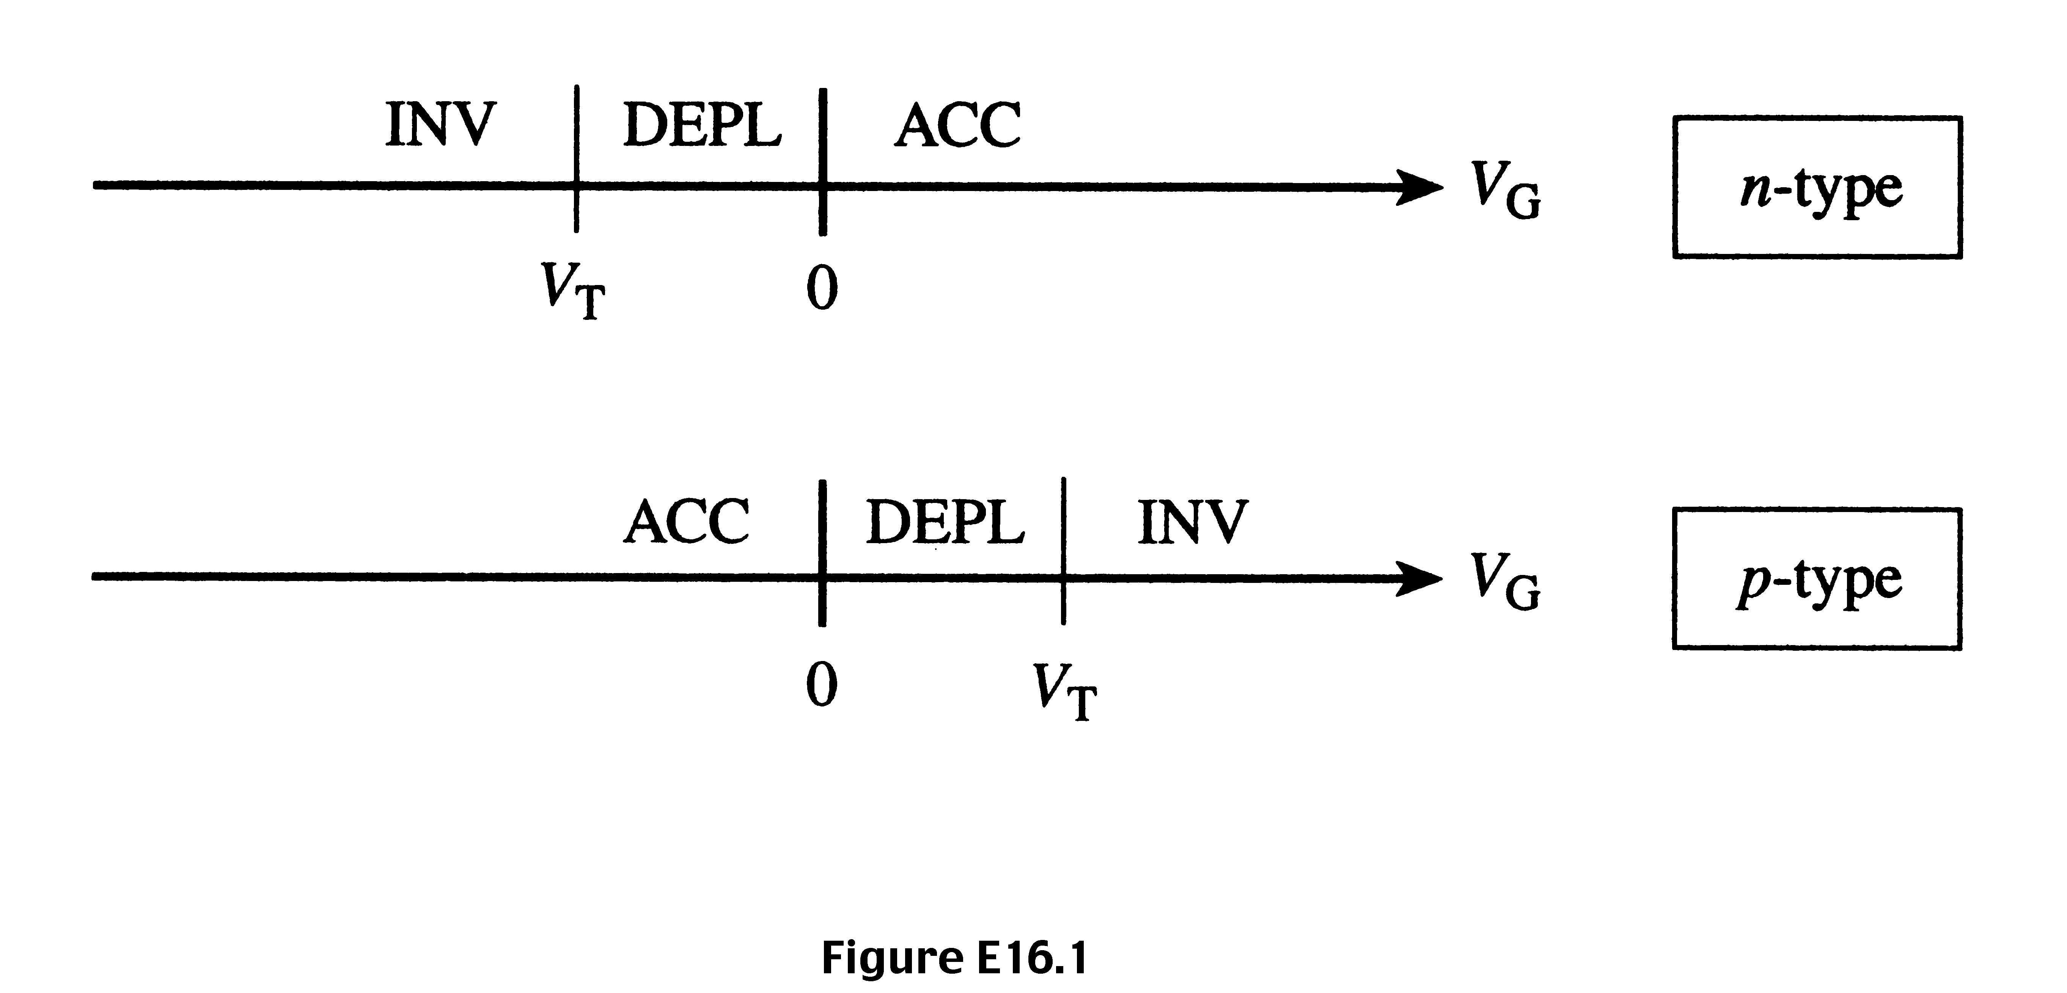
Example 1
Construct line plots that visually identify the voltage ranges corresponding to accumulation, depletion and inversion in ideal n-type Si (i.e. p-channel) and p-type Si (i.e. n-channel) MOS devices.
Answer:

